Slide 1
CRI3I3 Pemrograman Perangkat Bergerak
Course Profile

Slide 2
Outline
OUTOUTLINELINE
Learning scheme
Course rules
Scoring
Syllabus
References
Mid-term & Final Project Description

Slide 3
Learning scheme
Self-directed & Problem-based Learning
evaluation :
Quiz / Assignment
Mid-term Project
Final Project

Slide 4
Course rules
Just listen what the lecturer tells you
Cheating and plagiarism, max score is D
Attendance is less than 60%, max score is C

Slide 5
Scoring (may change)
Quiz & Assignment (25%)
Mid-term Project (30%)
Final Project (45%)

Slide 6
Syllabus
Mobile Technology
Intro Flutter & Dart
Layout part 1
Layout part 2
User Interaction
Navigation & Notification
Review
Mid-term Project Presentation
Data Storage 1
Data Storage 2
Maps & Place
Networking
Data Storage 3
Camera & Media
Review
Final Project Presentation

Slide 7

Any question?

Slide 8
CTI3I3 Aplikasi Perangkat Bergerak
Mobile Technology

Slide 9
Outline
Mobile Application Architecture
Mobile Technologies & SDKs
Tools

Slide 10
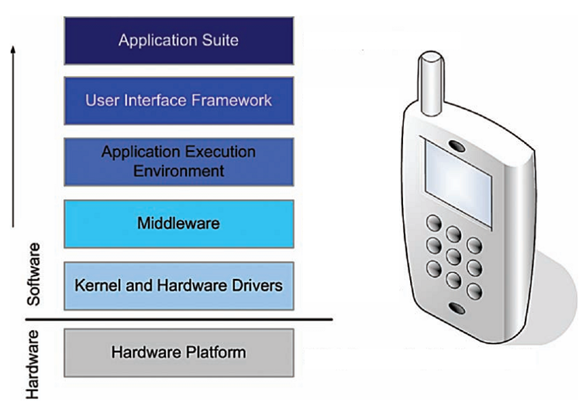
Mobile Application A rchitecture

Slide 11
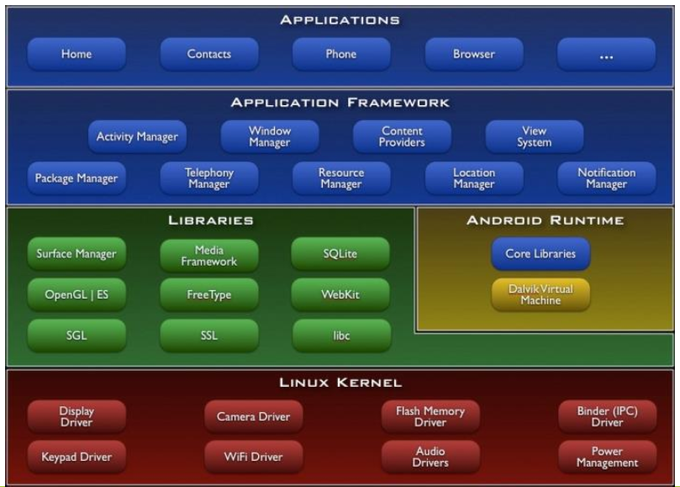
Android Application Architecture

Slide 12
Mobile Technologies Now
Location-based Service
Maps, Routes
Motion sensor
Accelerometer, Gyroscope, Camera
Near Field Communication
AI Camera
Image beautifying, Video stabilizer
Payment & Banking Apps

Slide 13
Mobile App SDKs
Native
Android SDK (Google)
iOS SDK (Apple)
Xamarin (Microsoft)
Windows Phone SDK (Microsoft, discontinued)
BlackBerry SDK (BlackBerry Ltd.)
Hybrid
Cordova (Apache)
React Native (Facebook)
Flutter (Google)
Ionic
WebWorks (BlackBerry Ltd.)

Slide 14
Mobile App Development Challenges
Small screen
Various mobile device screen resolution and width
Depend on internet connection
Data Storage (full offline / full online / hybrid)

Slide 15

Programming Language for Mobile
Java
Kotlin
C# / C++
Objective-C
Swift
Javascript
Dart
In this course, we will use:
Dart
One of the most popular language
JS-like, Simple
Flutter SDK
One of the mobile hybrid platforms
Lots of docs & tutorials

Slide 16
Mobile App with Database
Offline (SQLite)
Online
Realtime (Firebase)
Web service (REST)

Slide 17
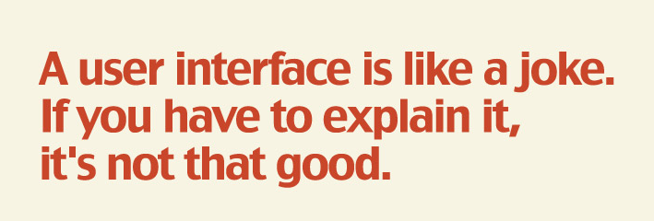
Mobile Developers Type
UI/UX Designer
Balsamic Wireframe
Marvel App
Figma
Miro

Slide 18

Mobile Developers Type
Full-stack Developer
Translate from design into layouts
Create the controller to bridge the frontend and backend

Slide 19
Tools Makes You Better
IDE
Visual Studio Code
Android Studio
Emulator
Use if you don’t have Android phone
Warning: Uses lots of RAM, some hardwares / APIs don’t work properly

Slide 20
Any question?

Slide 21
References
https://docs.flutter.dev/

